Slide 1
Construction
Management
Information
System

Slide 2
Tech Phantoms
Artur Komissarov
Faith - Valentine Uzoka
Khaliq Minsariya
Krushnam Badami
Kyle Rumde
Srinath Bhaskaran
Varnika Srivastava

Slide 3
Roadmap
Sequence Diagram
Java Transformation Code
Package Diagram Component Diagram Deployment Diagram
1
3
5
2
4
6
Class Diagram
Layers & Partitions
Deliverable 4 Prototype Demonstration

Slide 4
Sequence Diagram
1

Slide 5

Confirm BluePrint

Slide 6
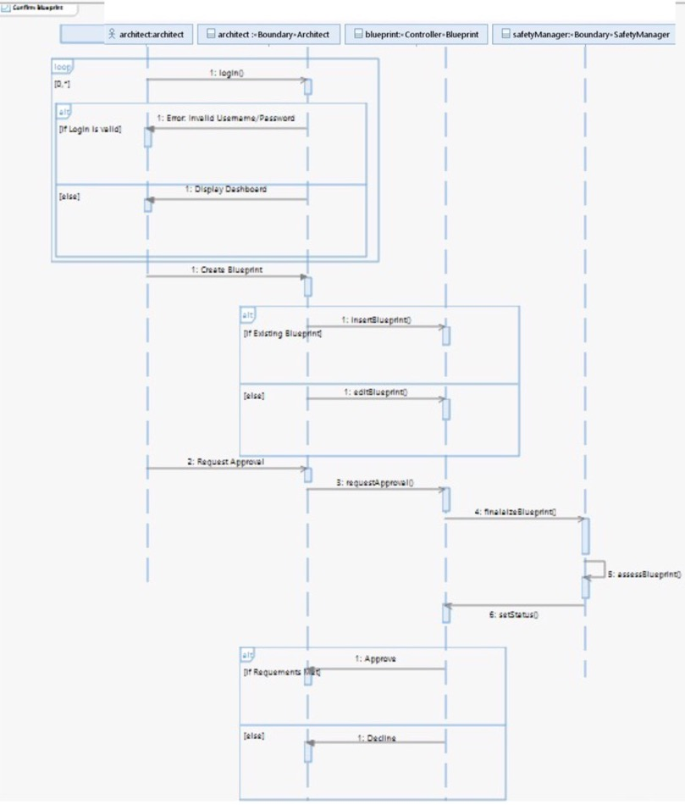

Slide 7

Process Purchasing Orders

Slide 8
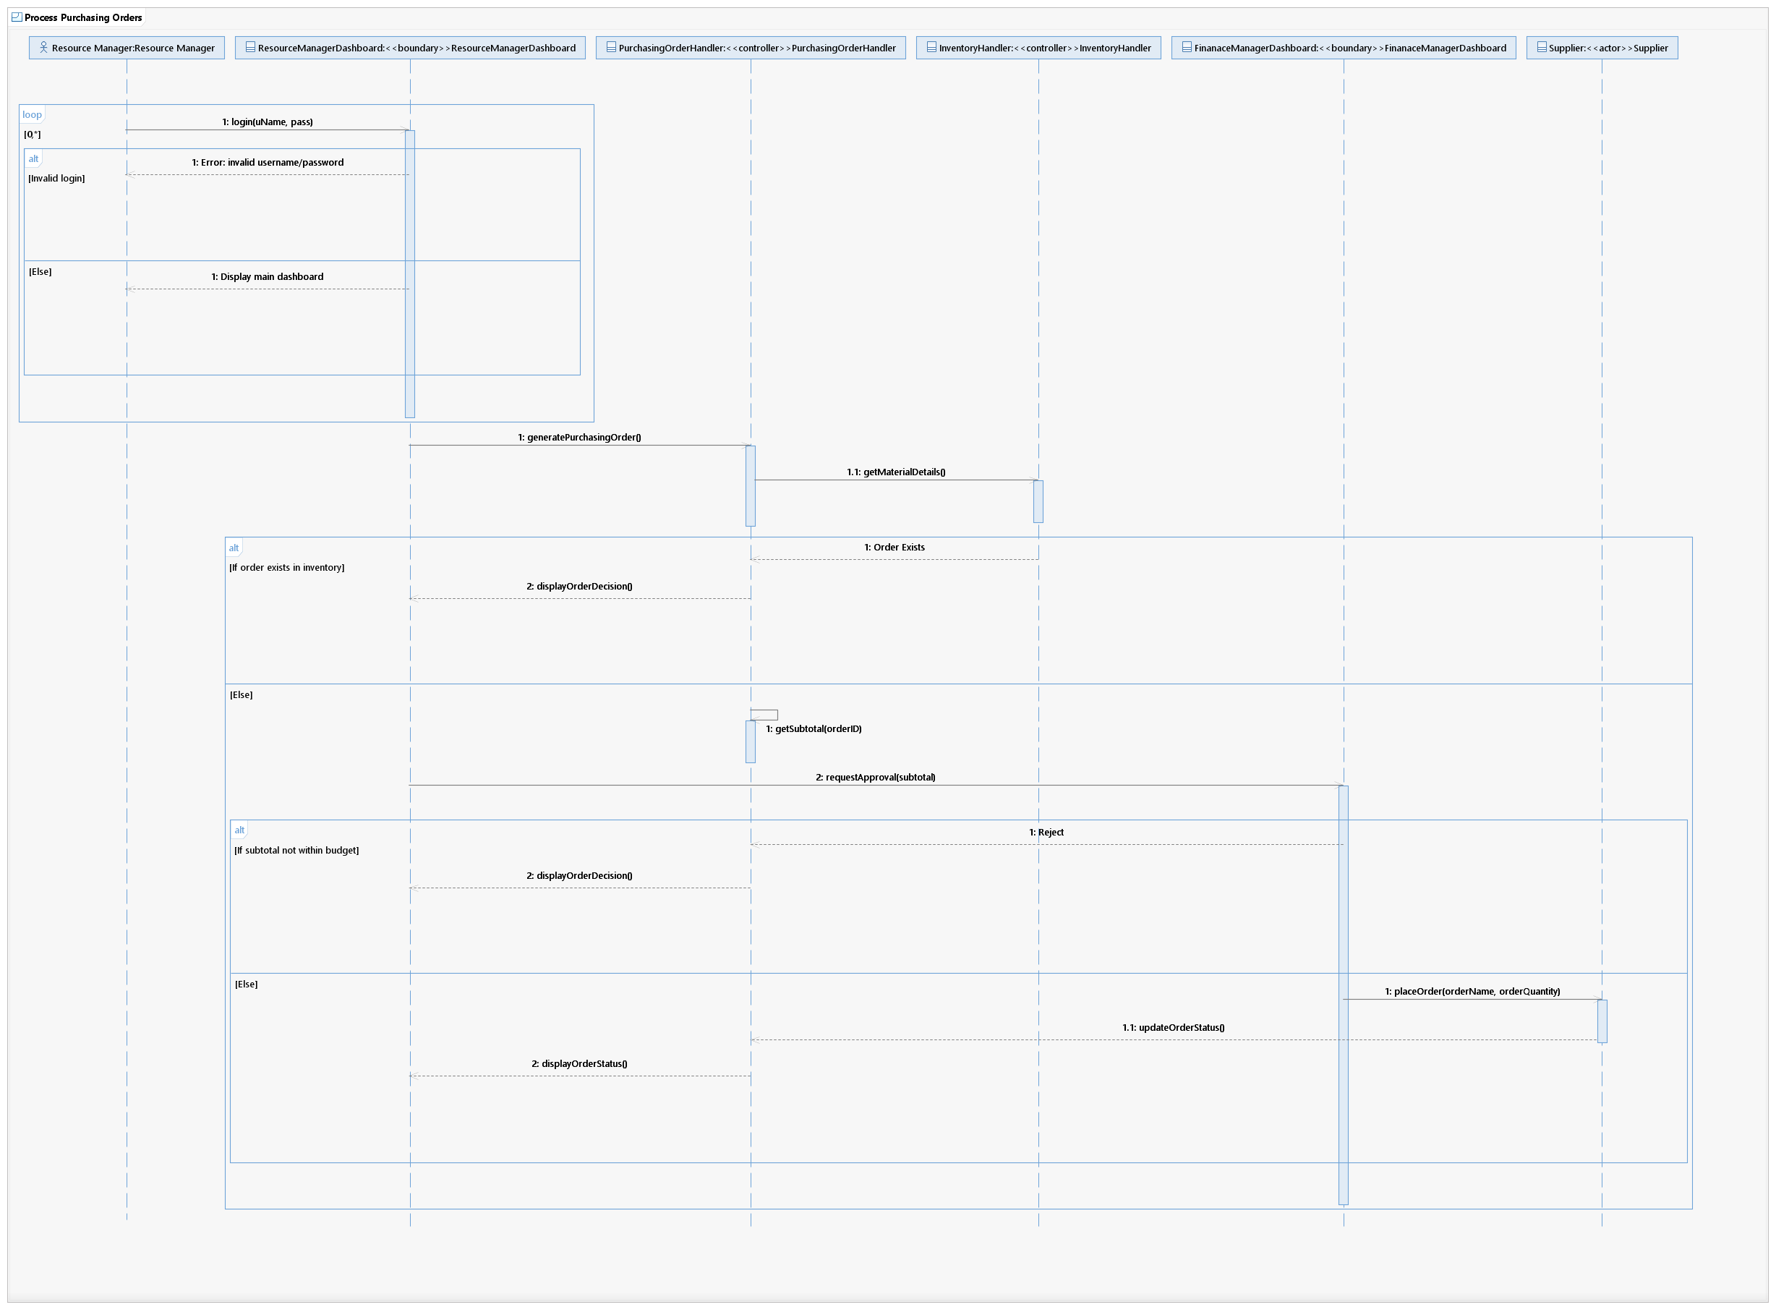
Process Purchasing Orders

Slide 9
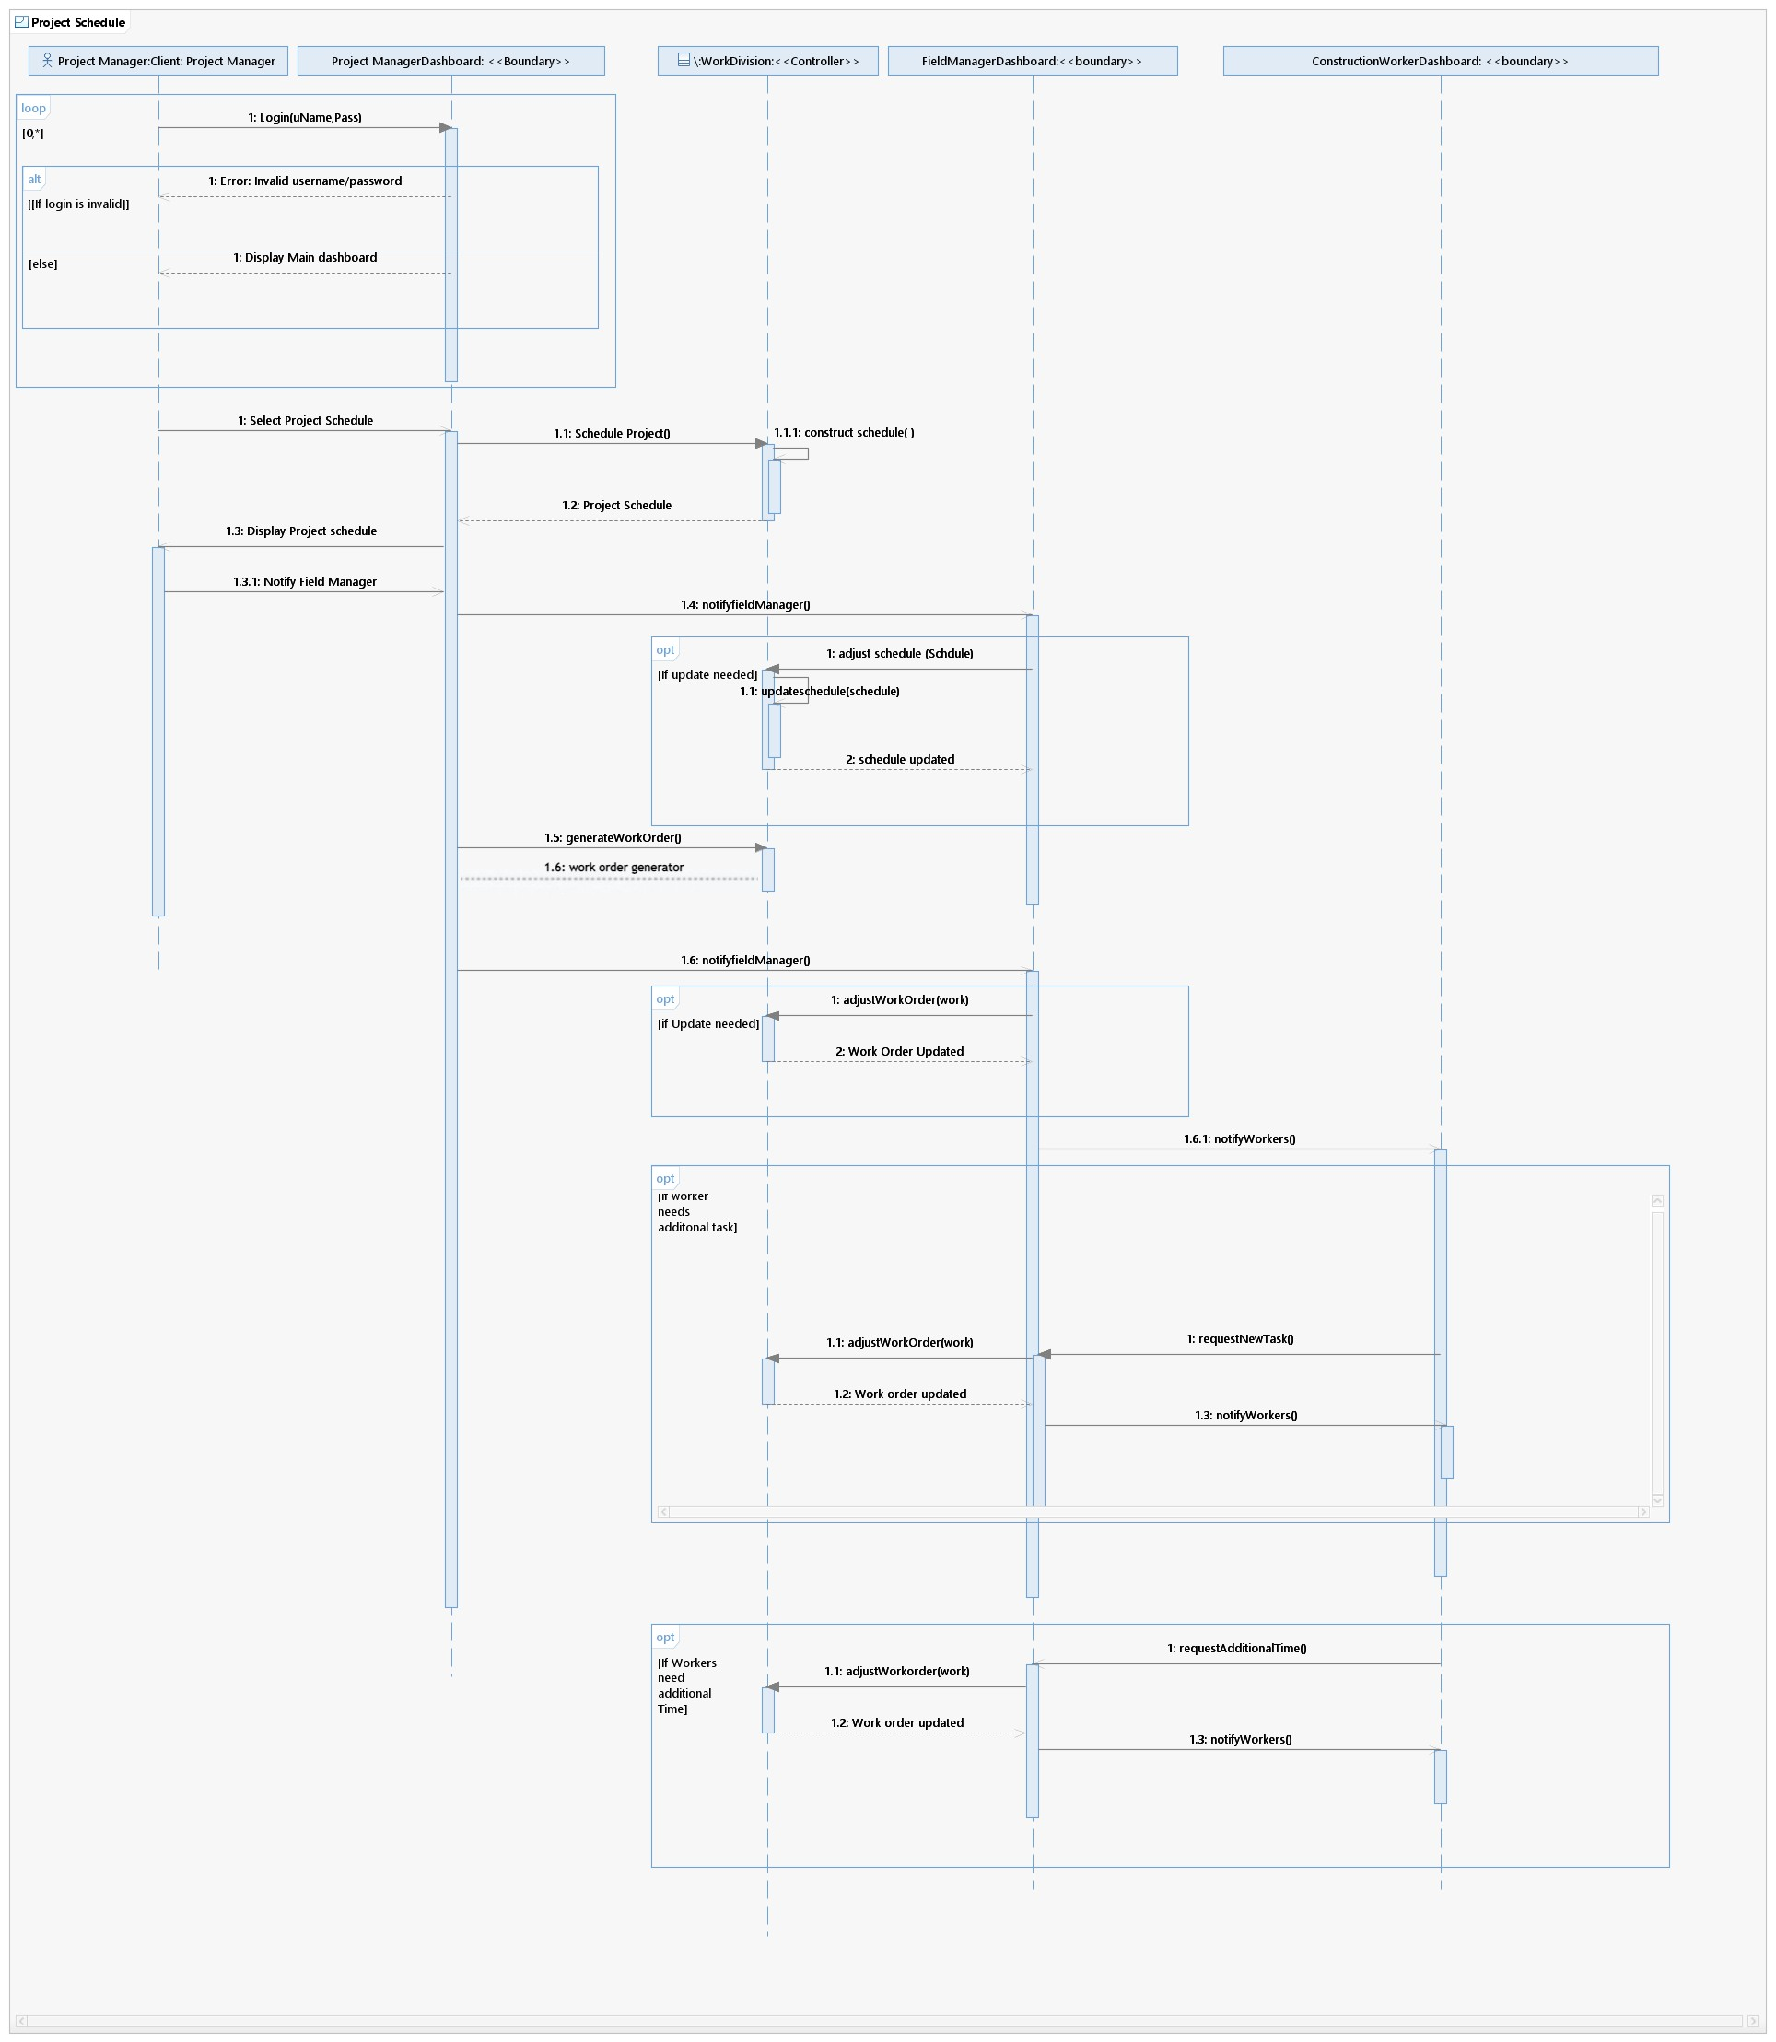
Schedule Project

Slide 10
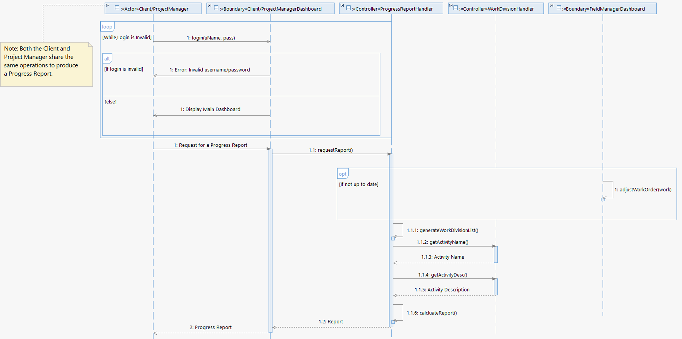
Produce Progress Report

Slide 11
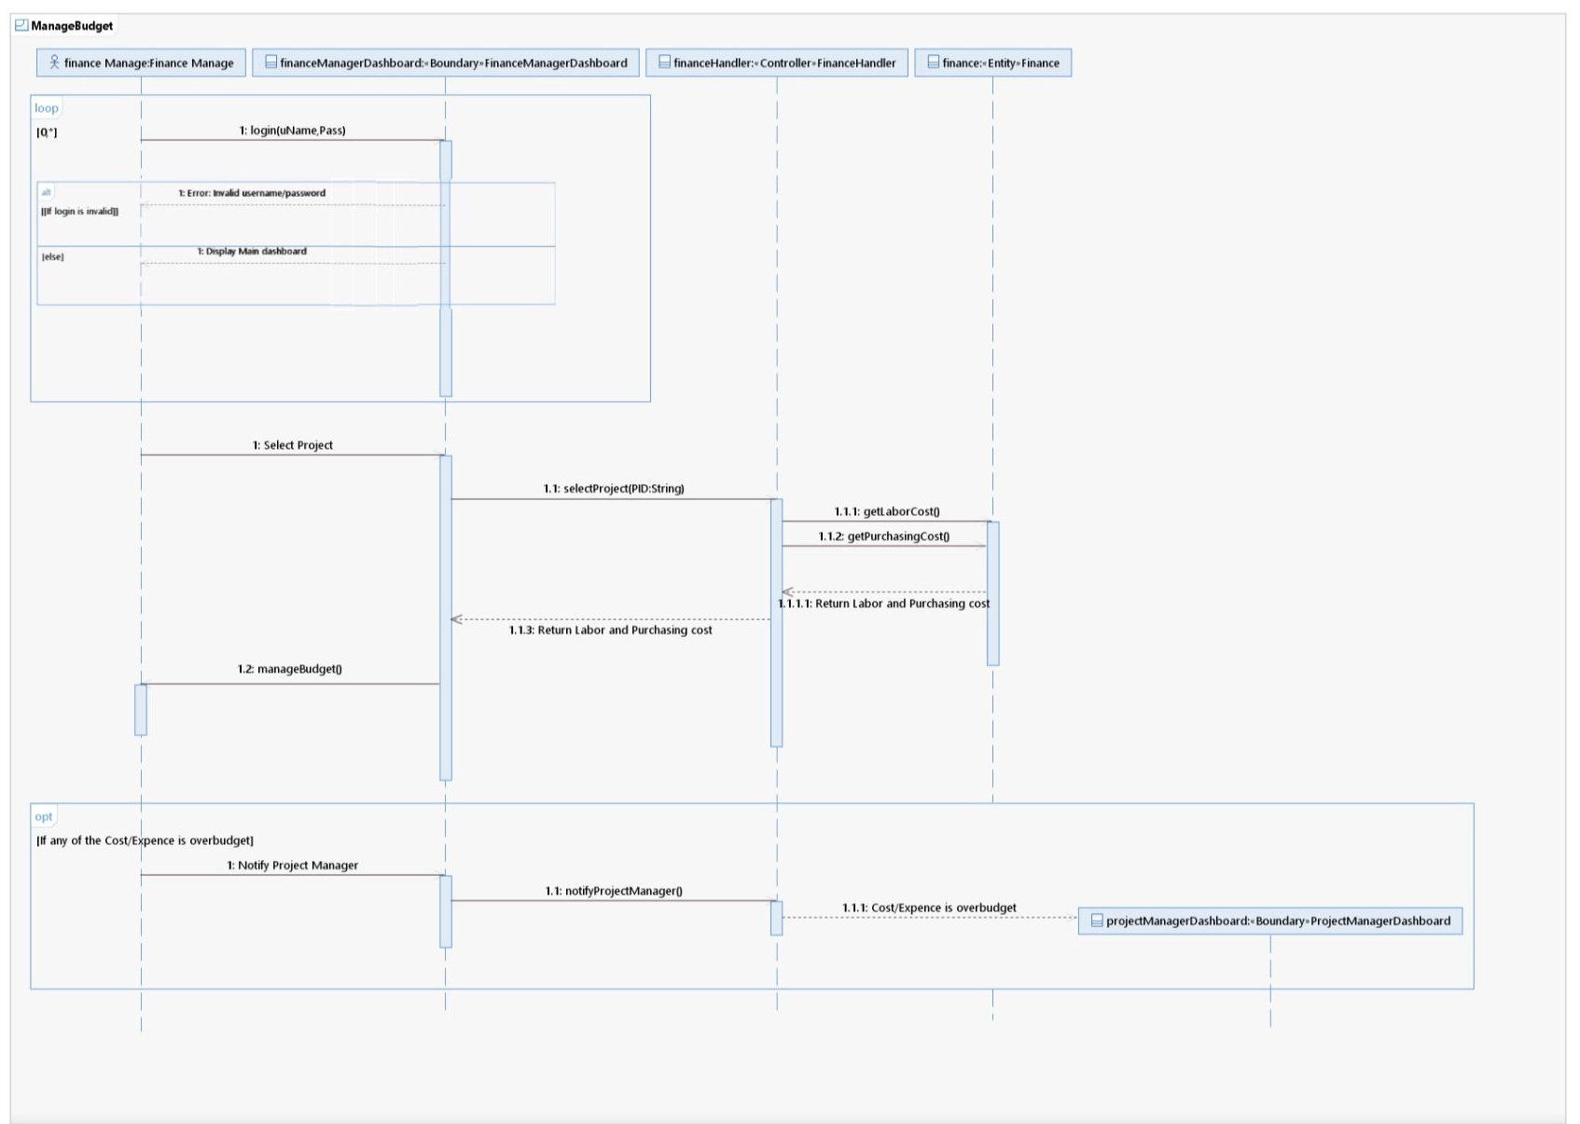
Manage Budget

Slide 12
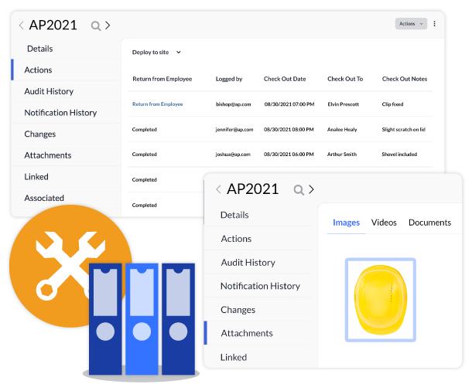
Tracking Equipment

Slide 13
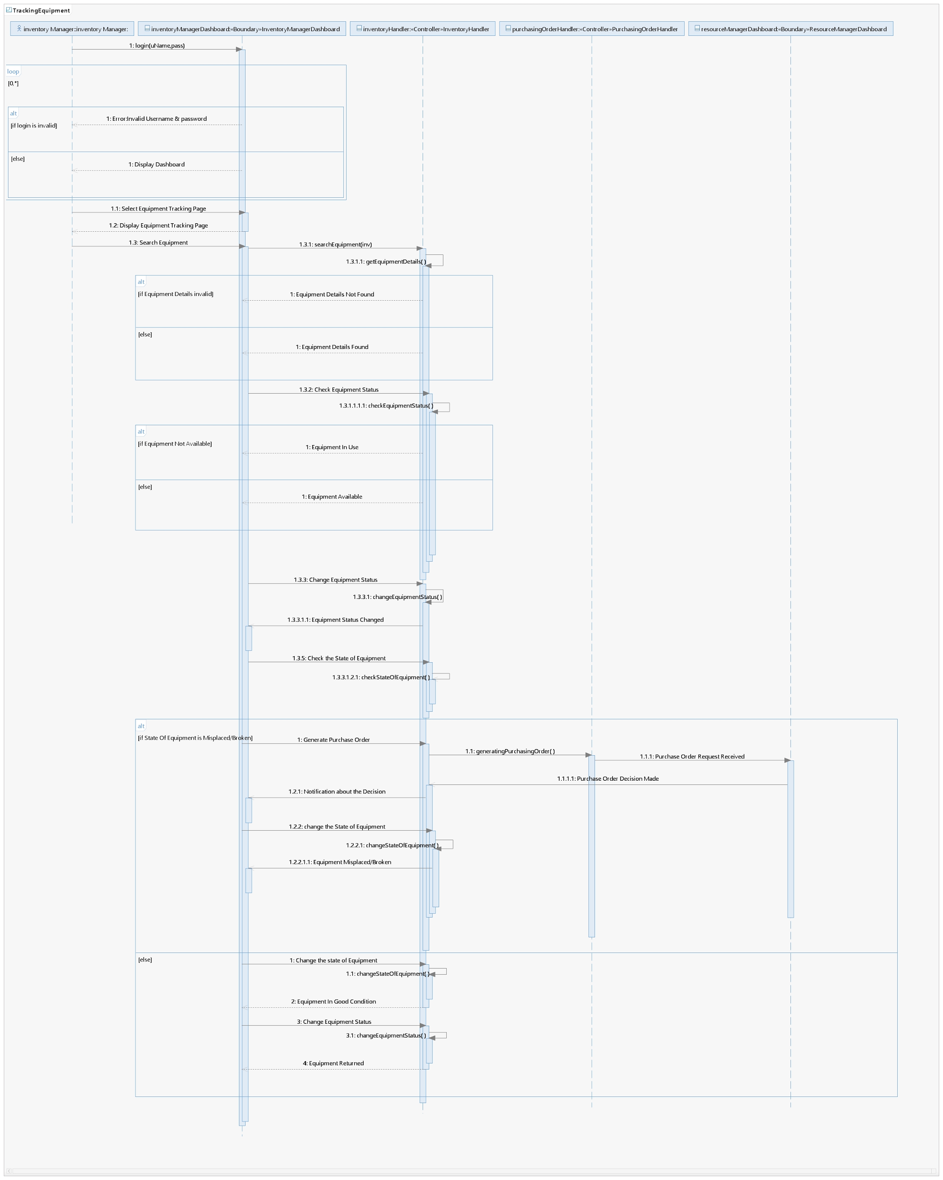

Slide 14
Class
Diagram
2

Slide 15
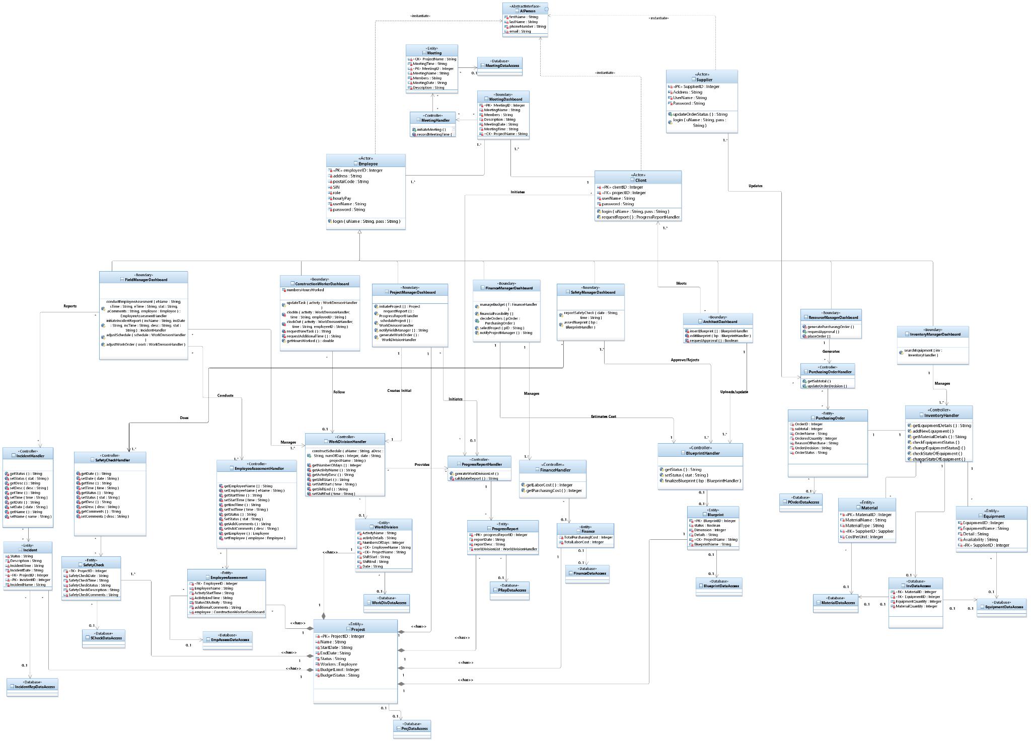

Slide 16
1
4
2
3

Slide 21
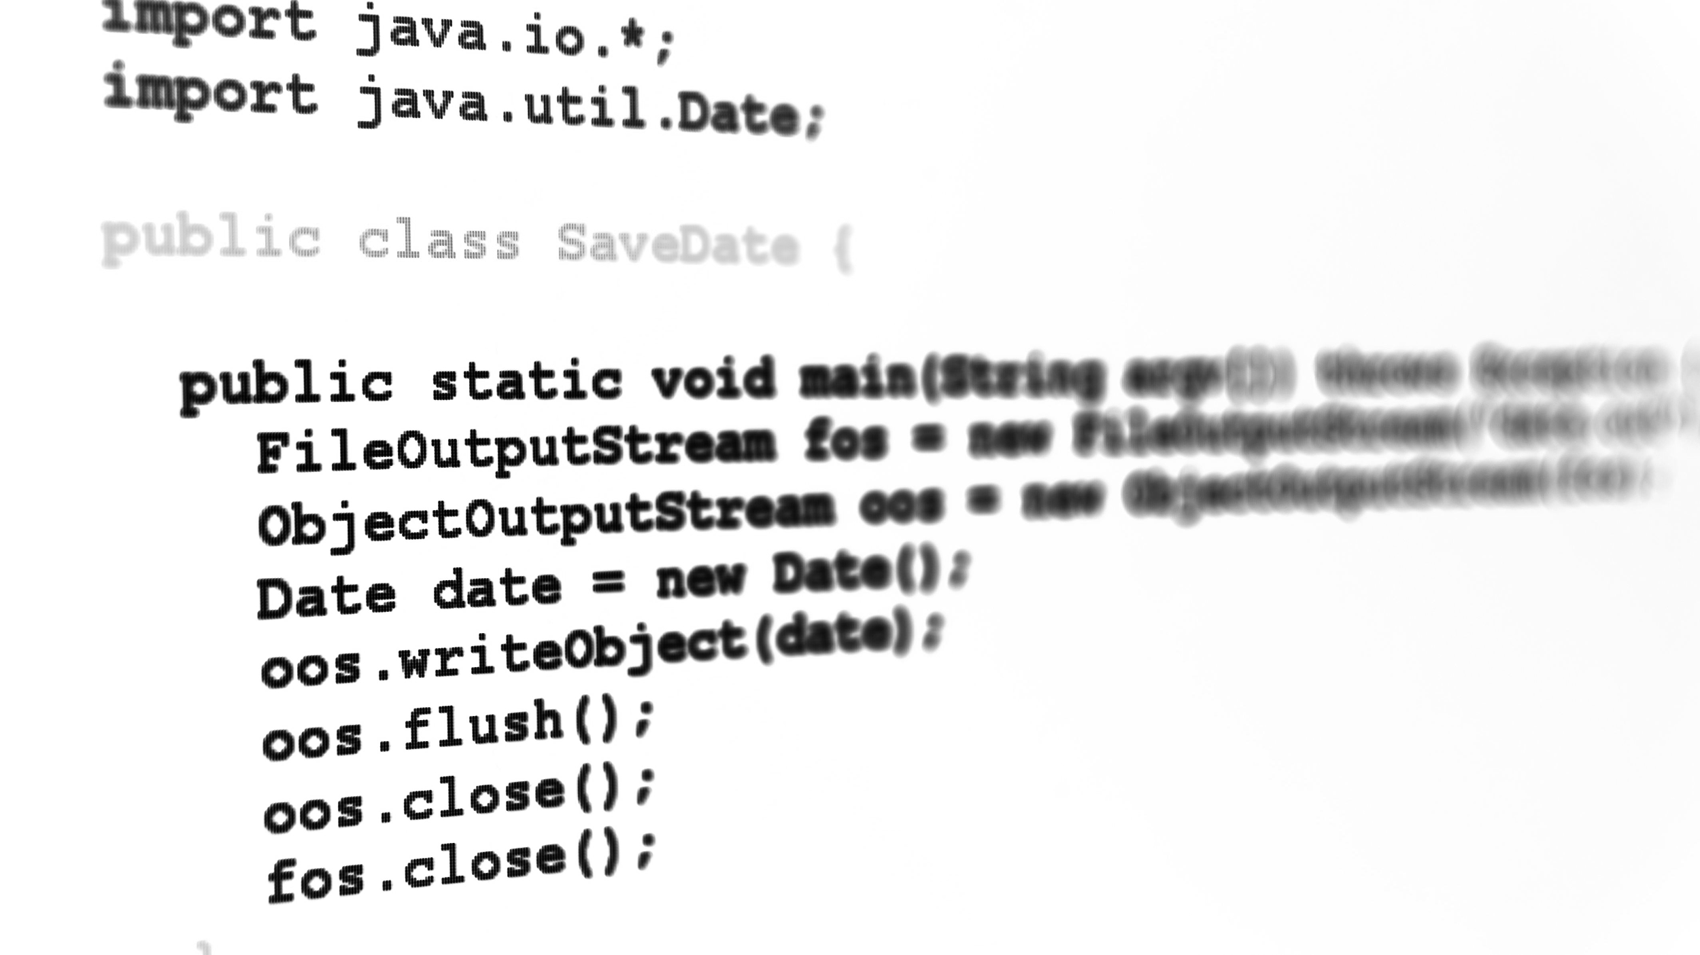
Java Transformation Code
3

Slide 22
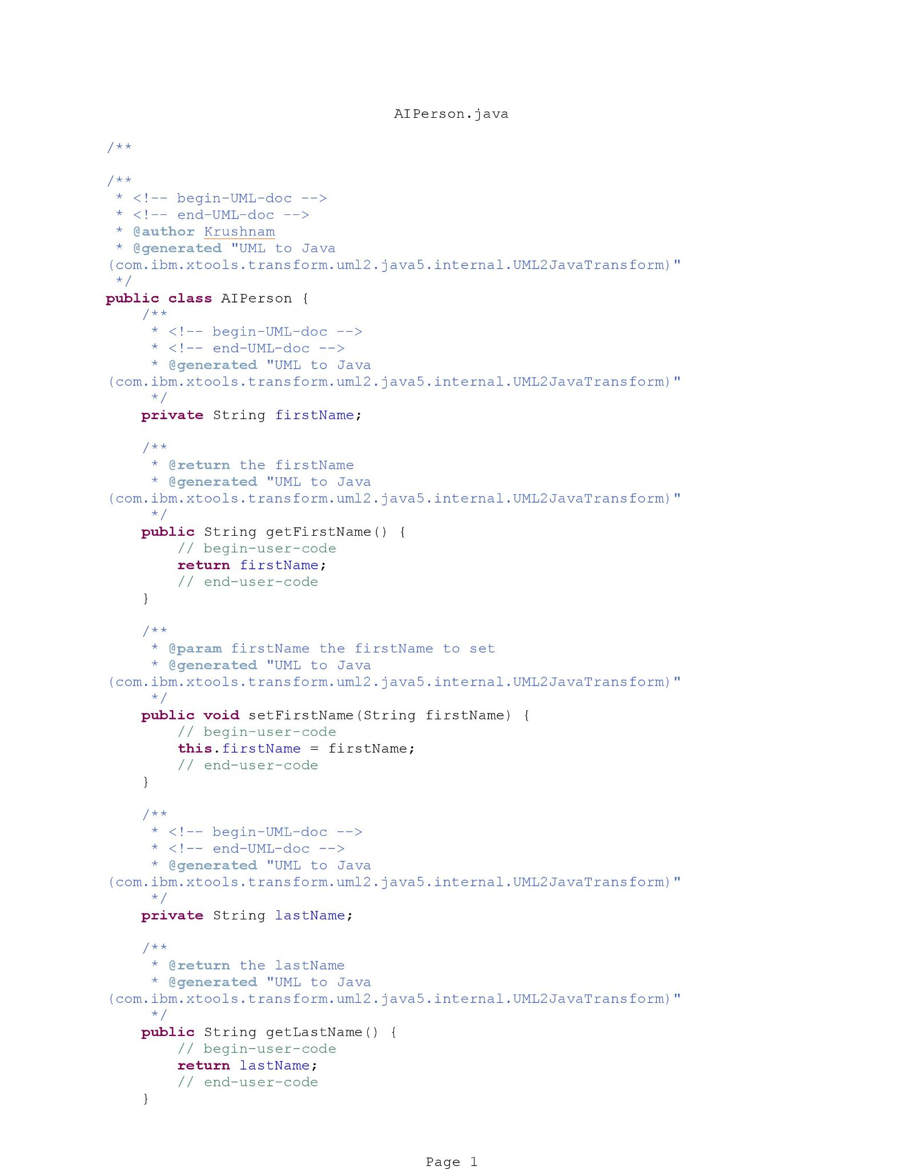
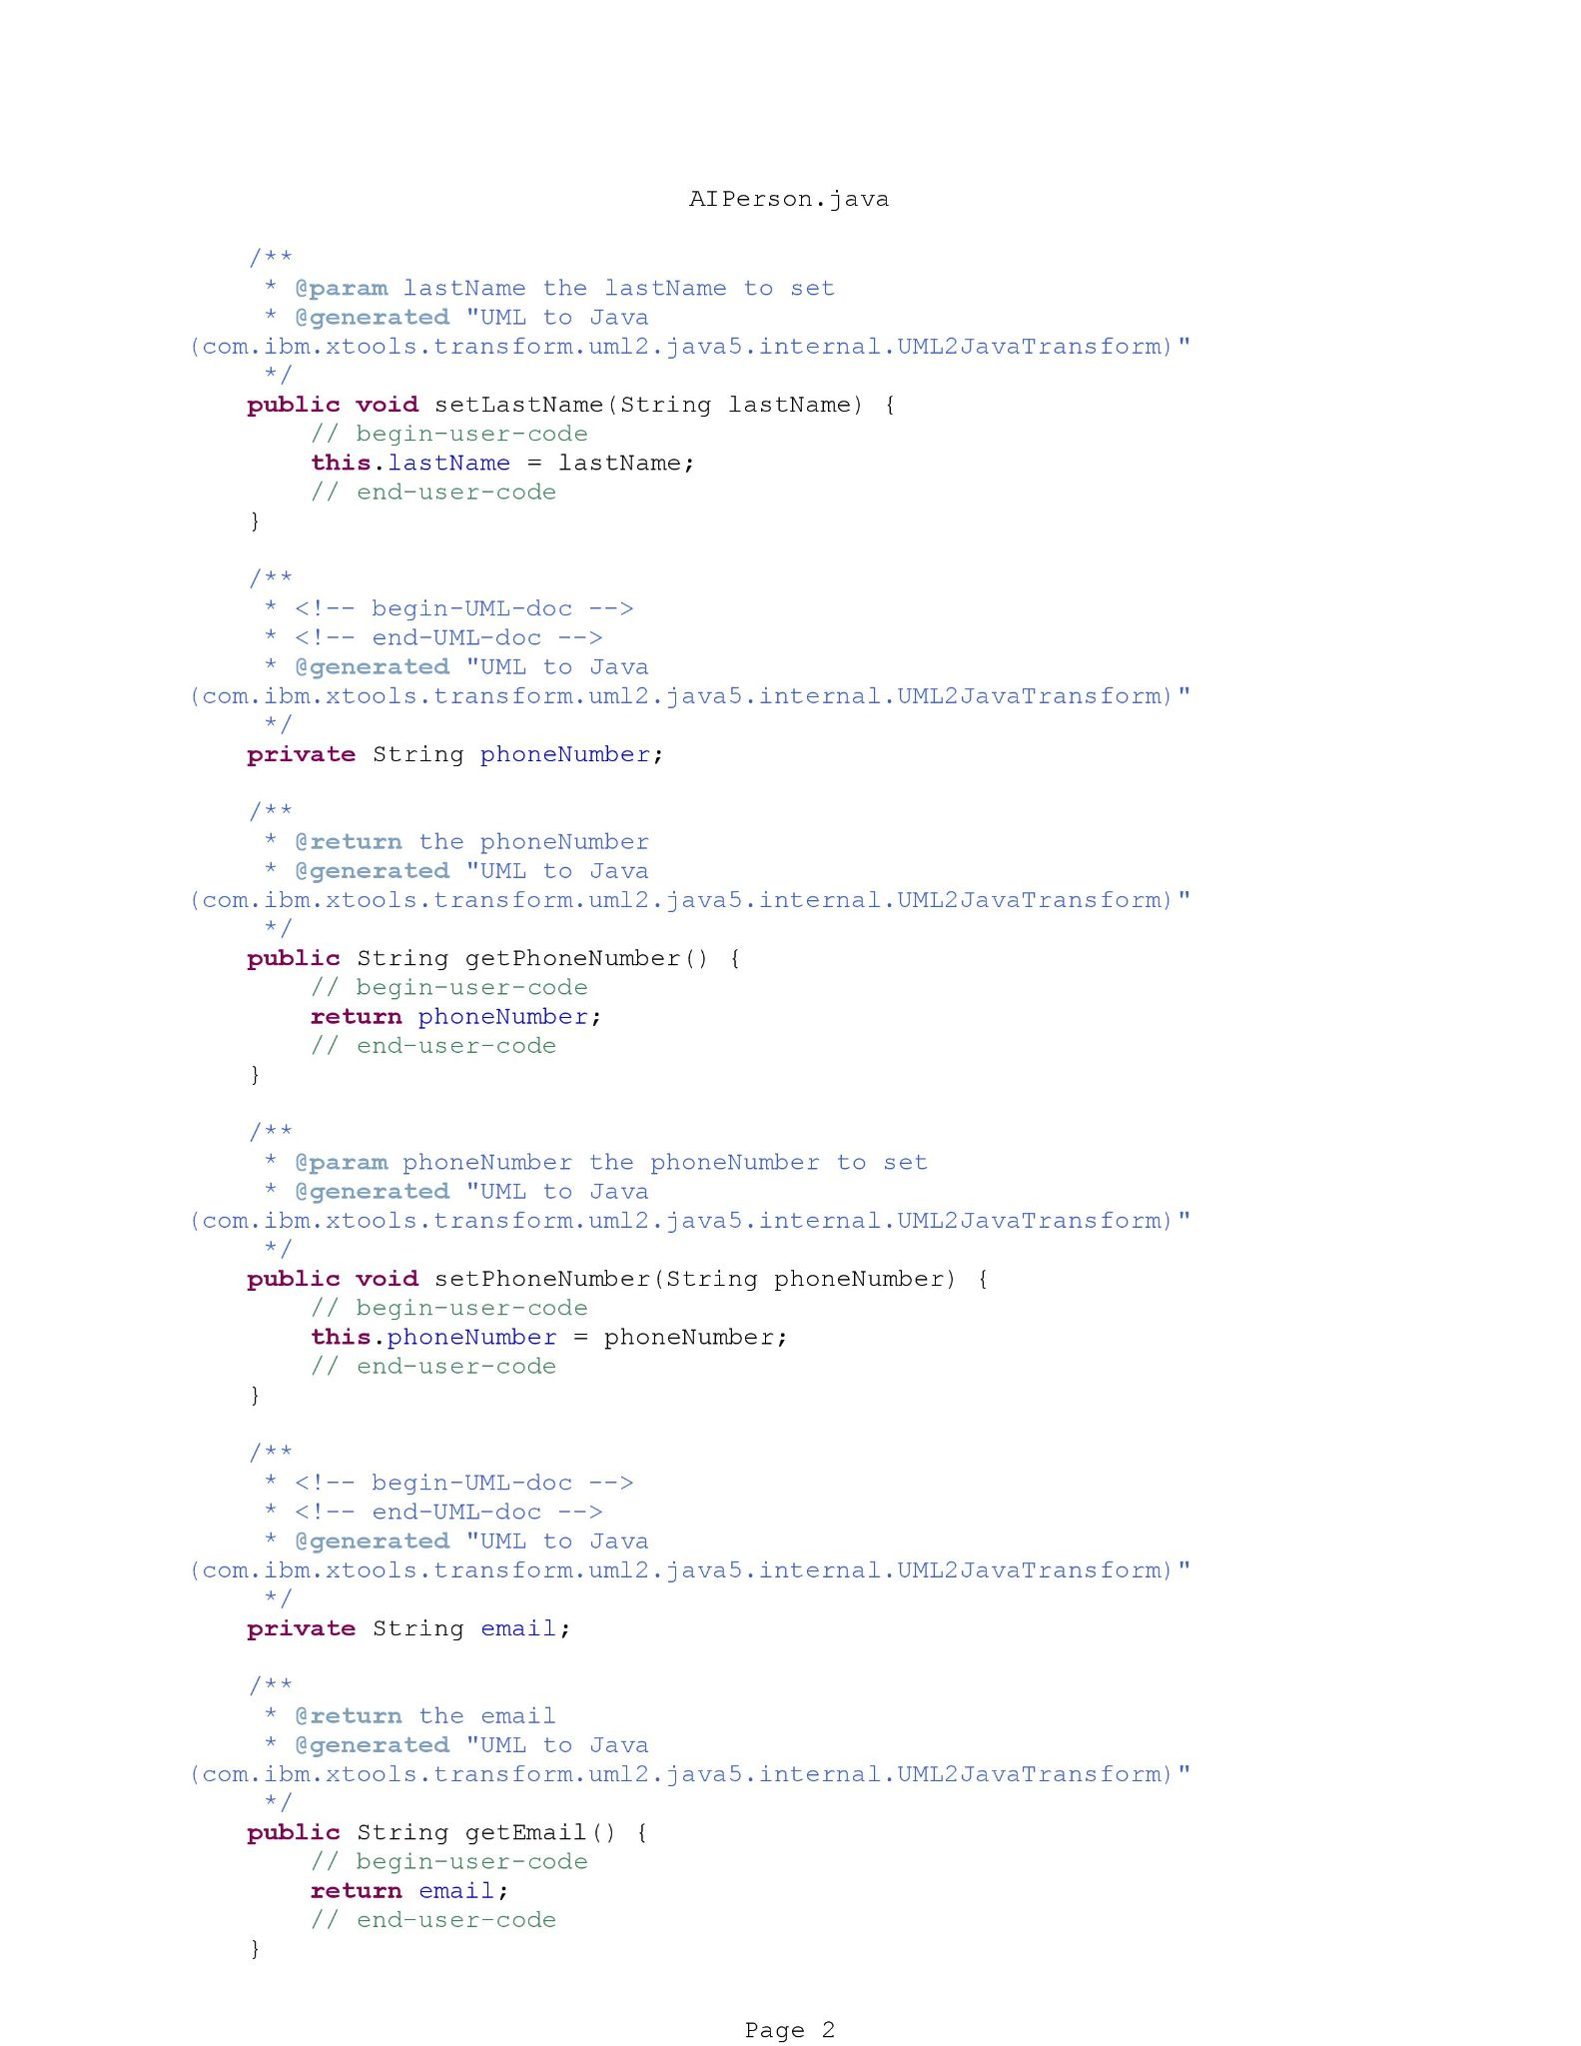
Java Code - Person

Slide 23
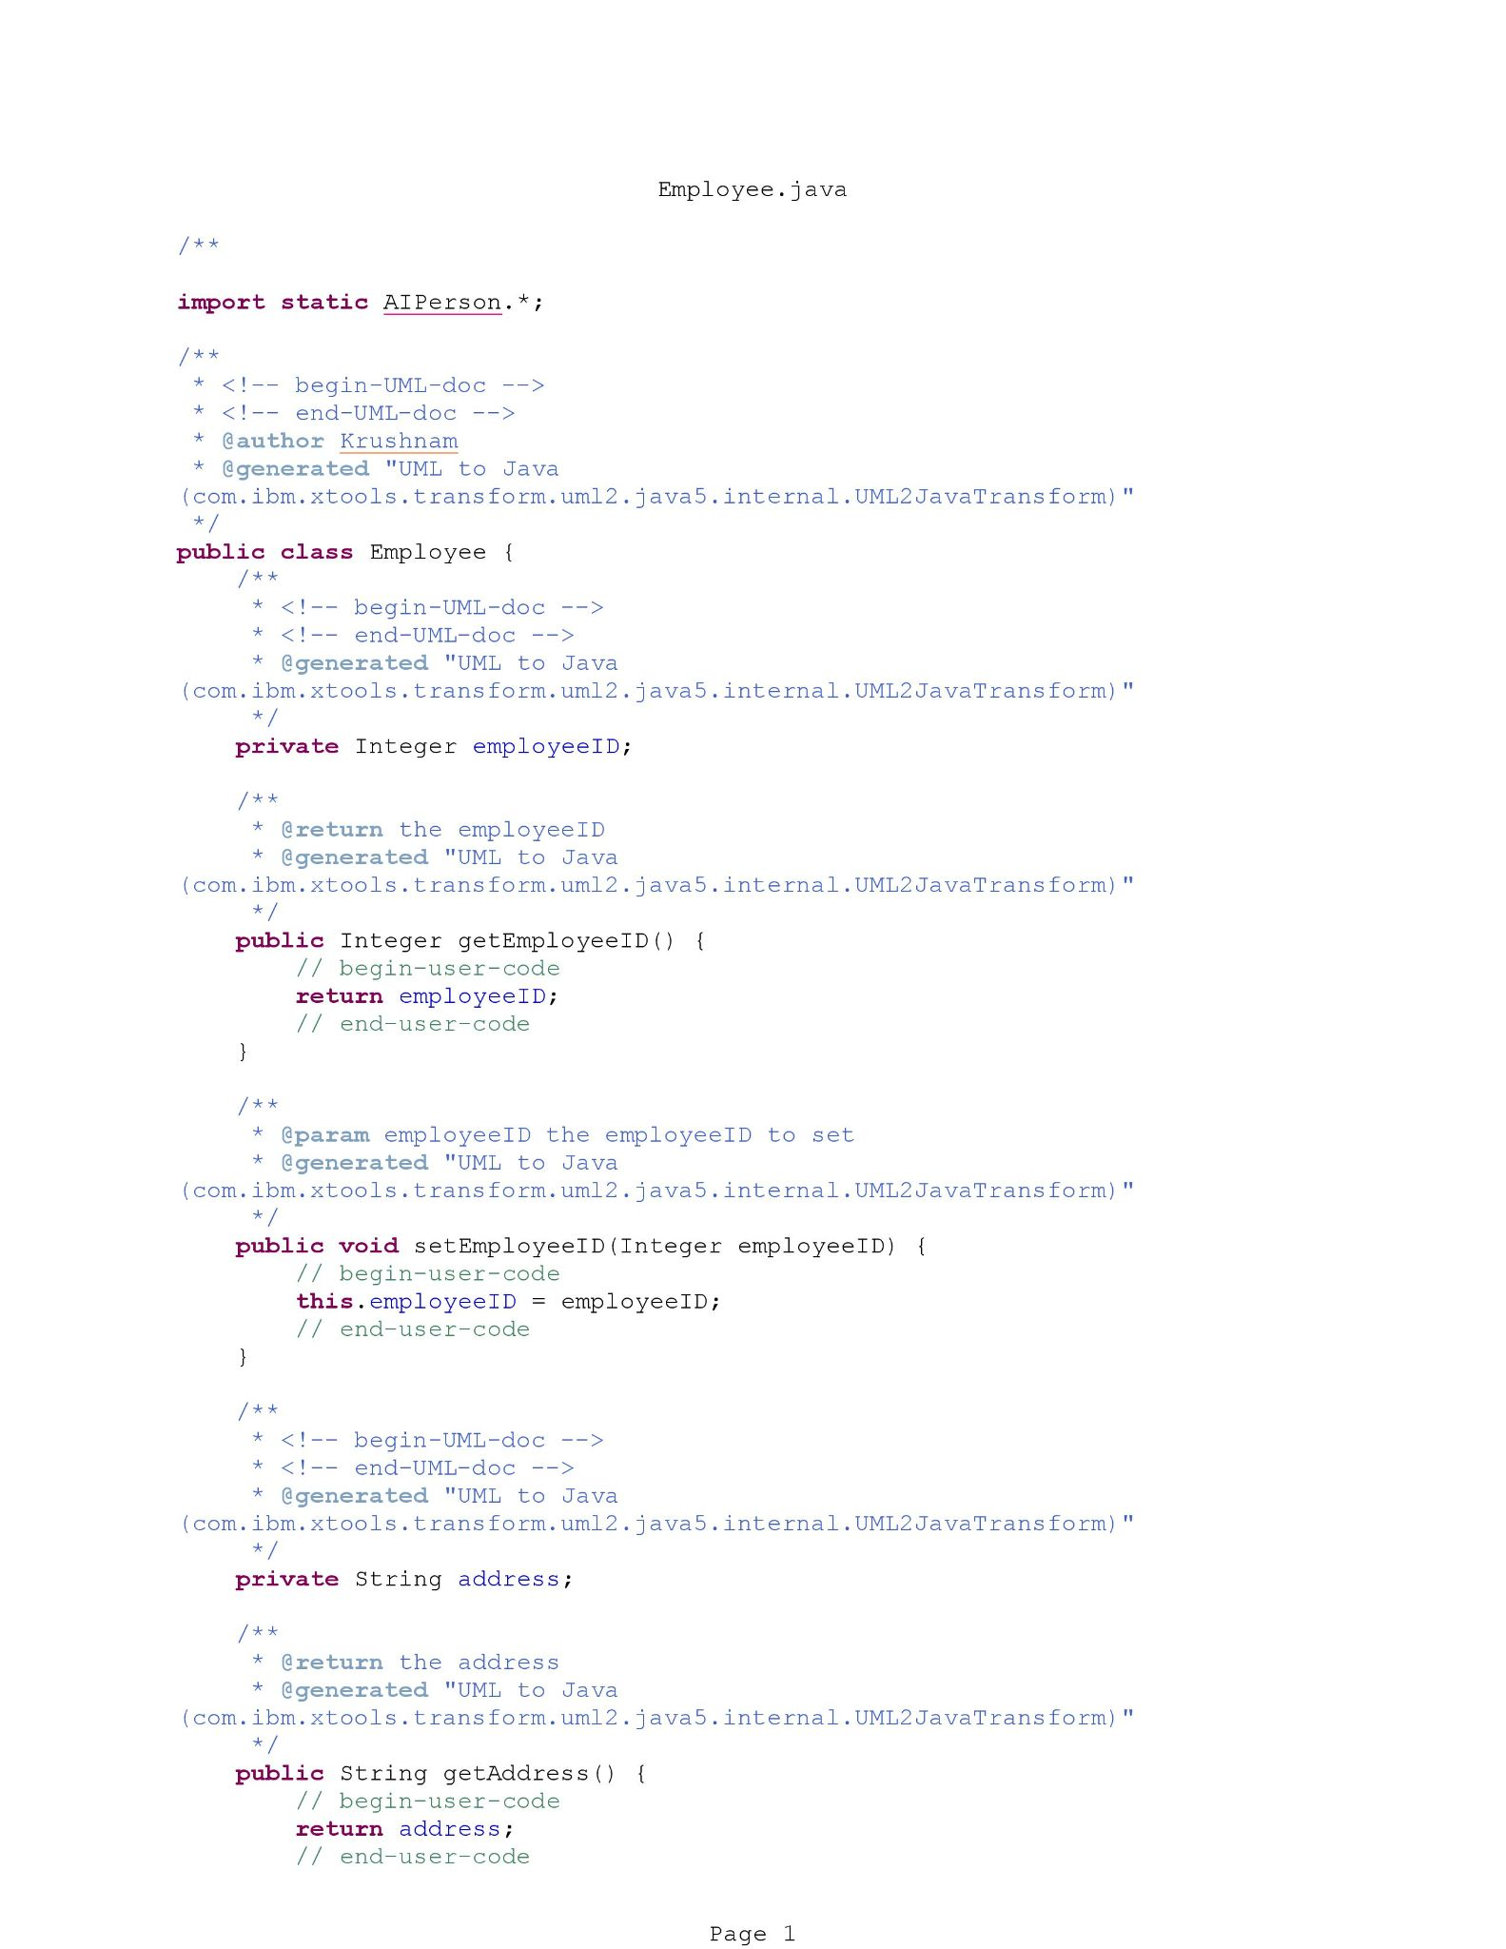
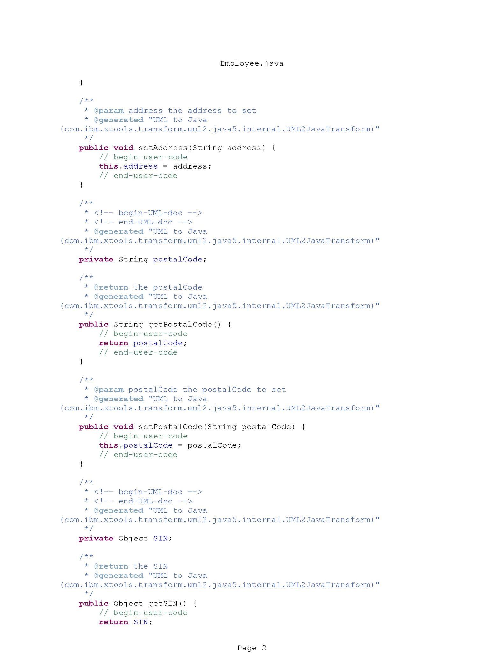
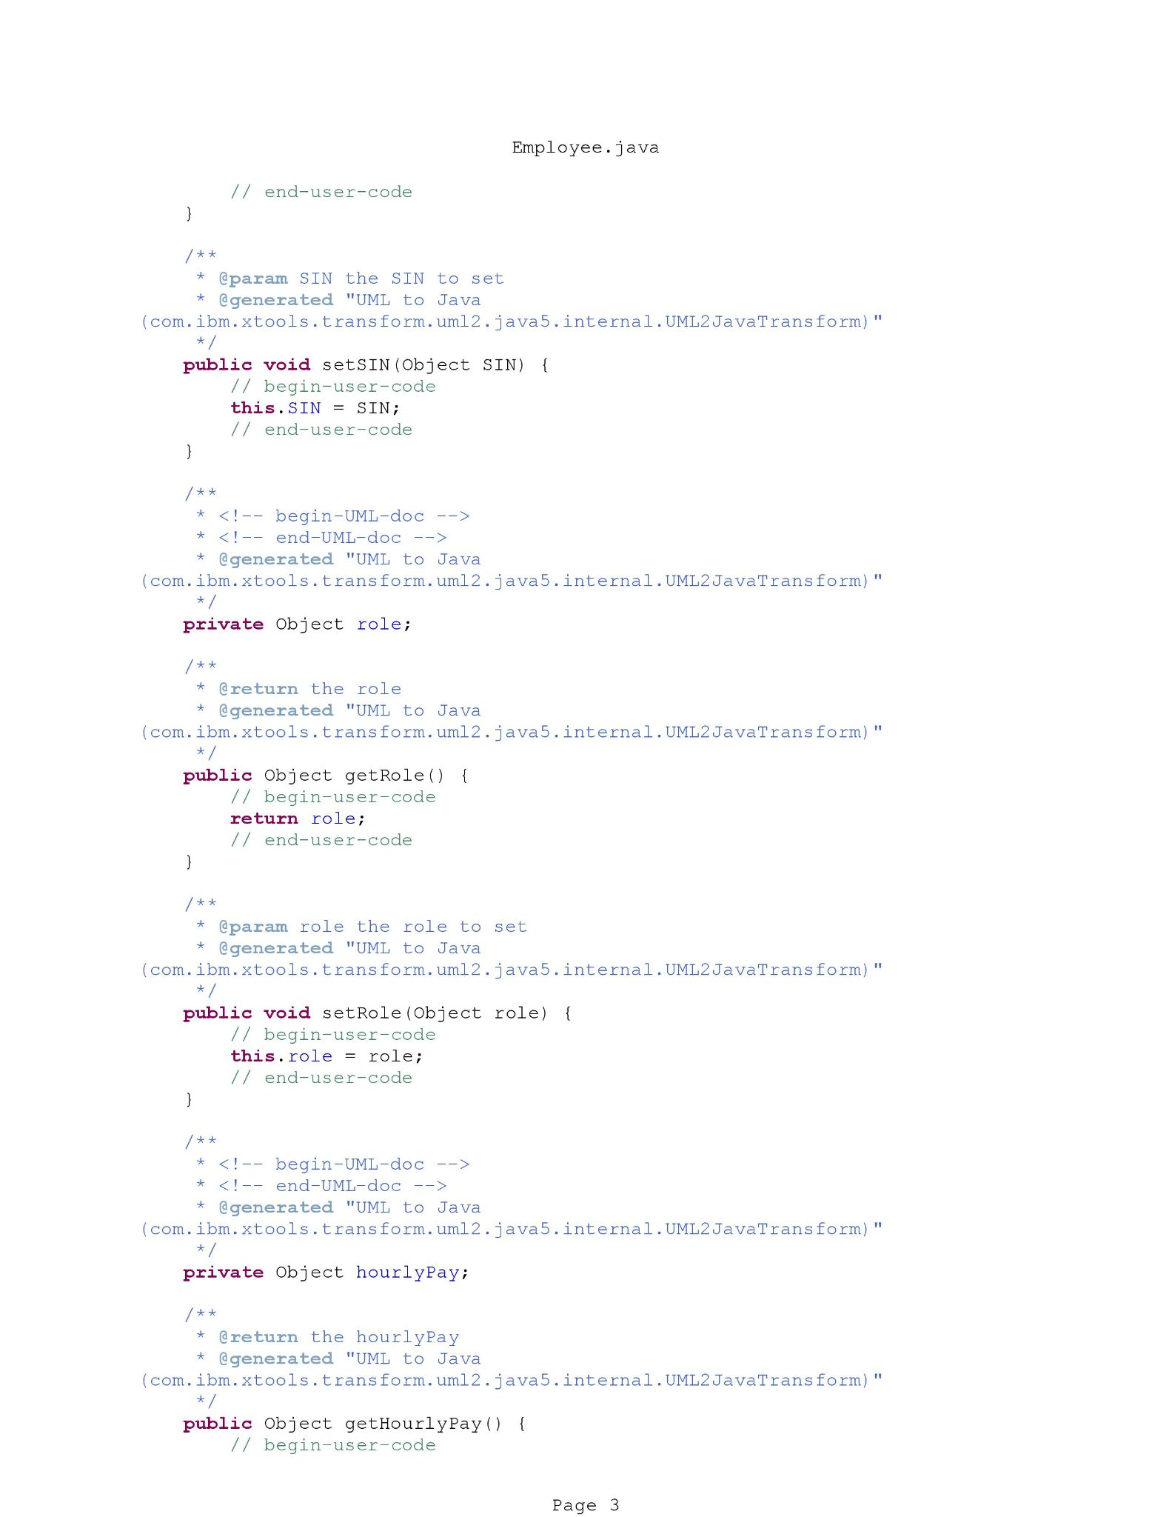
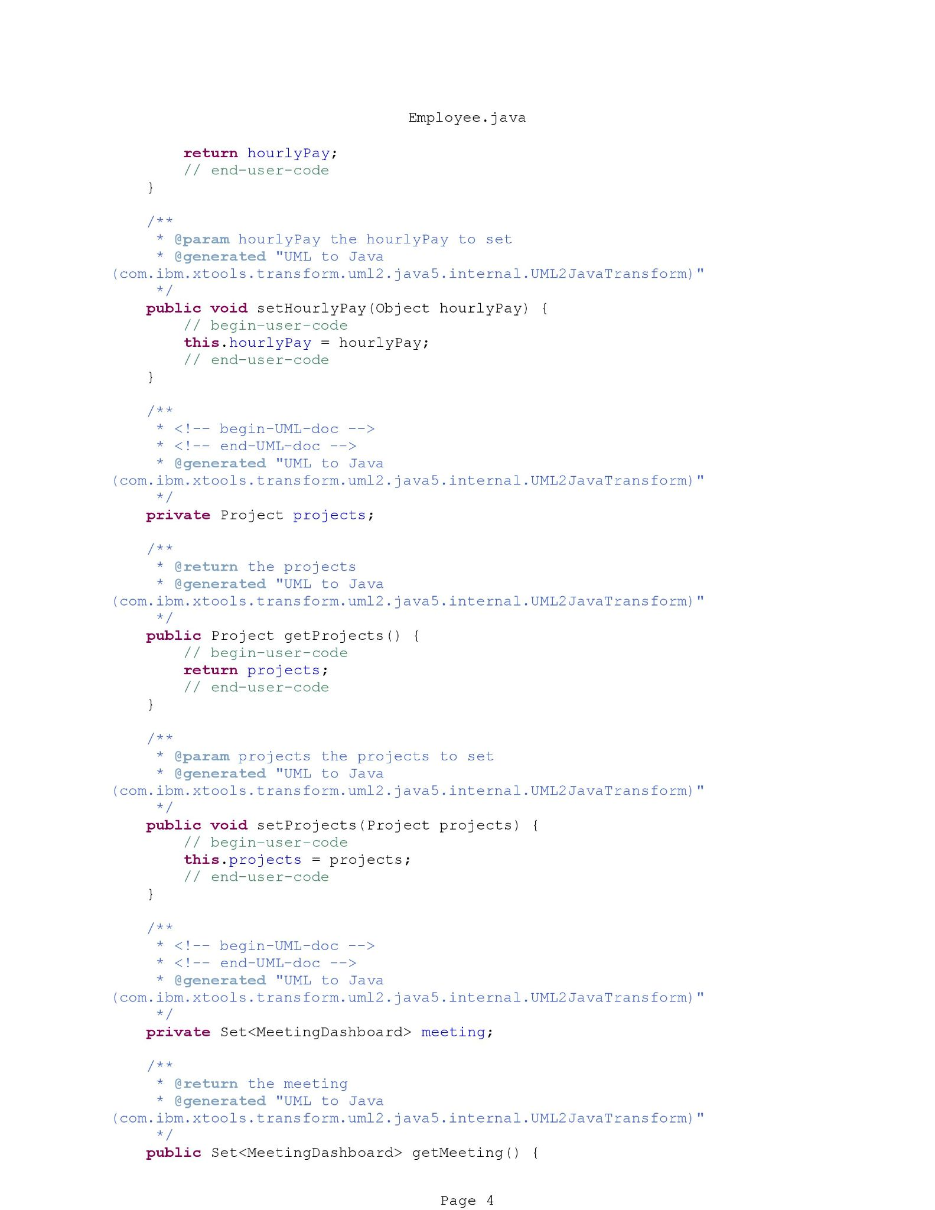
Java Code - Employee

Slide 24
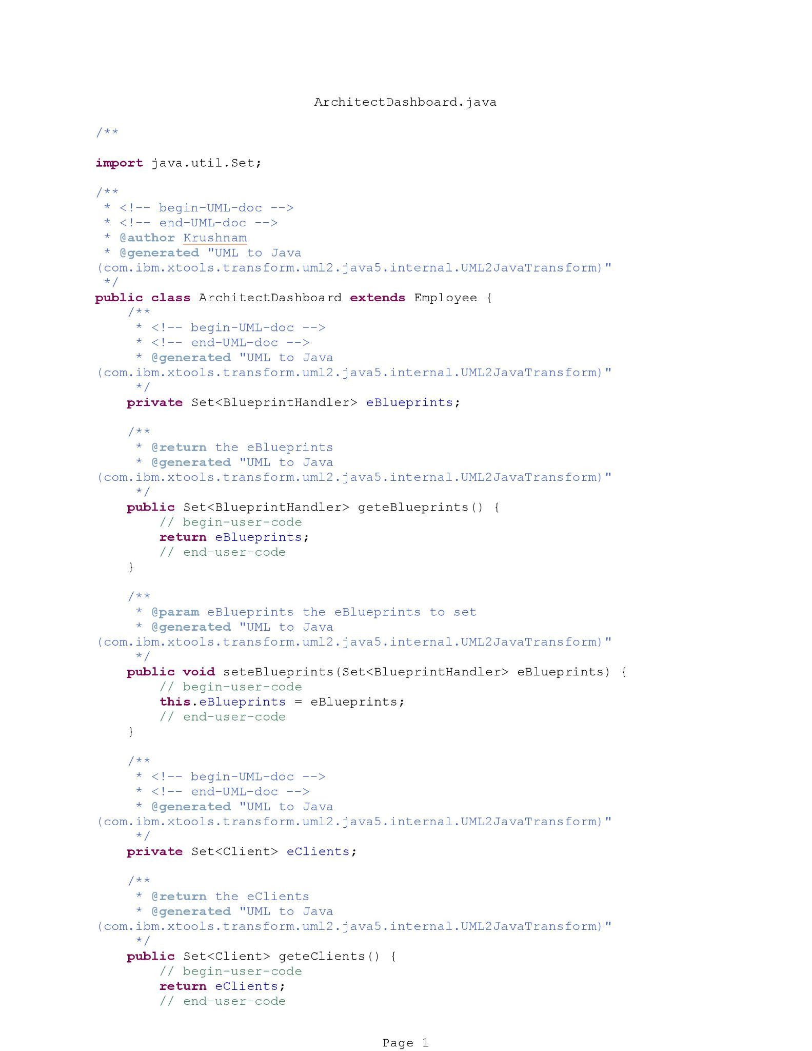
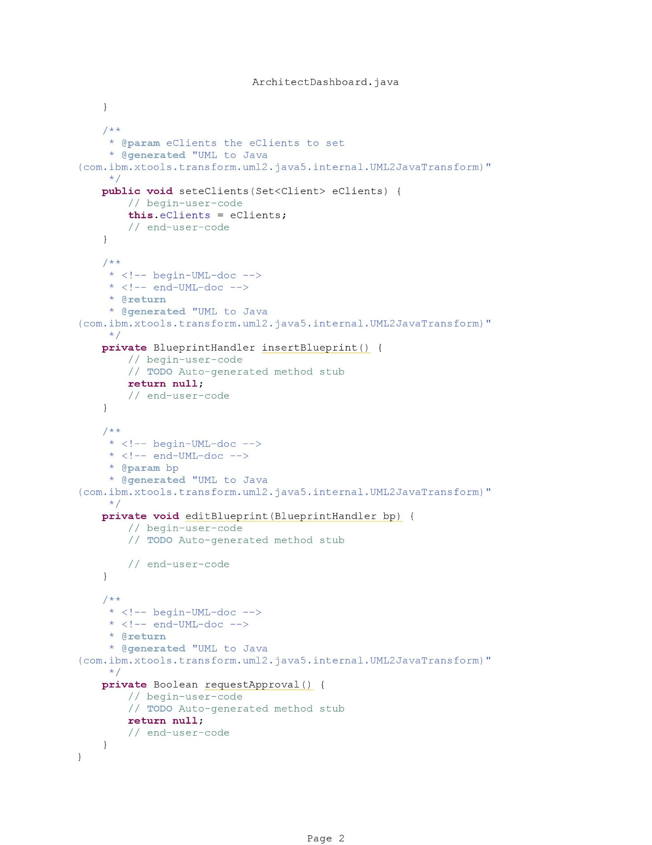
Java Code - ArchitectDashboard

Slide 25
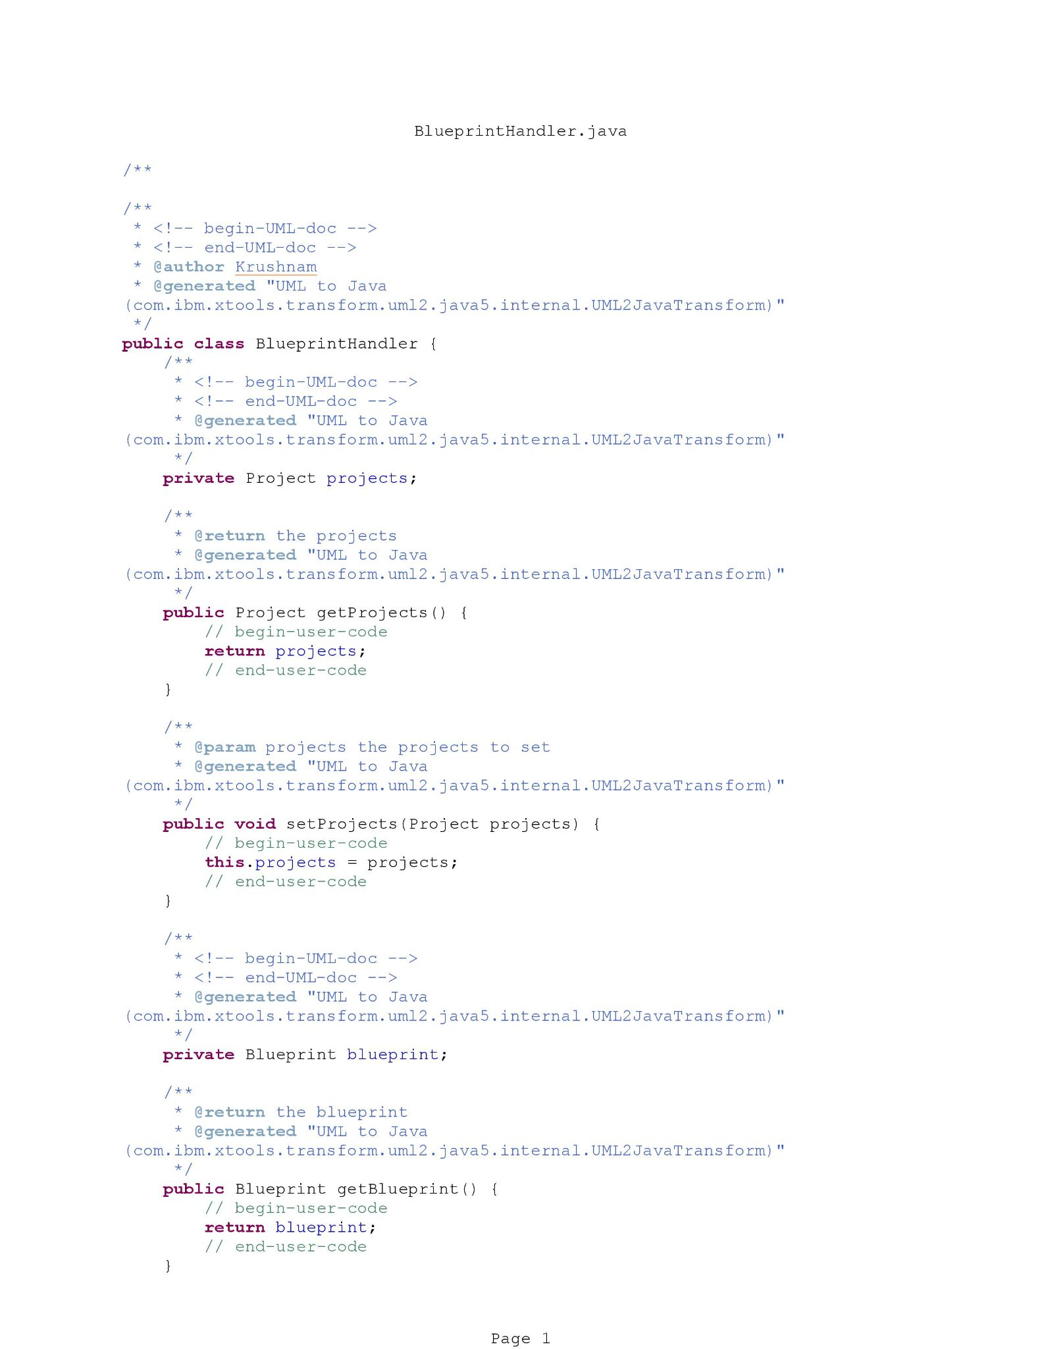
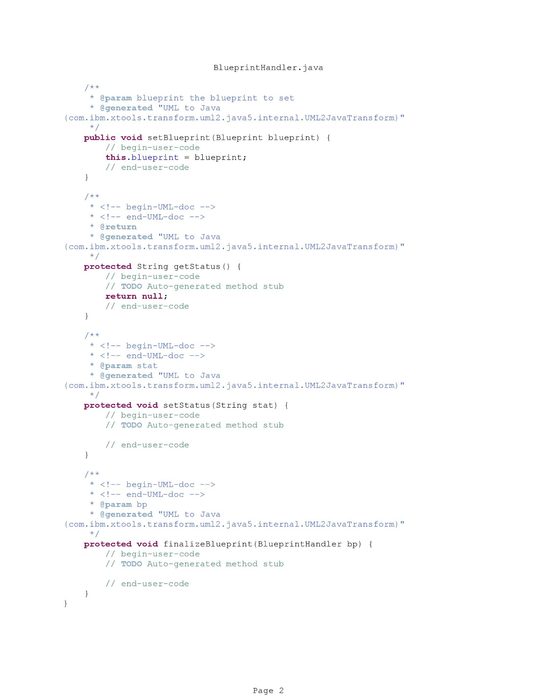
Java Code - BluePrintHandler

Slide 26
Layers and Partitions
4

Slide 27
BCED Approach
Boundary Classes
Control Classes
Entity Classes
Data Access Classes

Slide 28
Package, Component, and Deployment Diagram
5

Slide 29
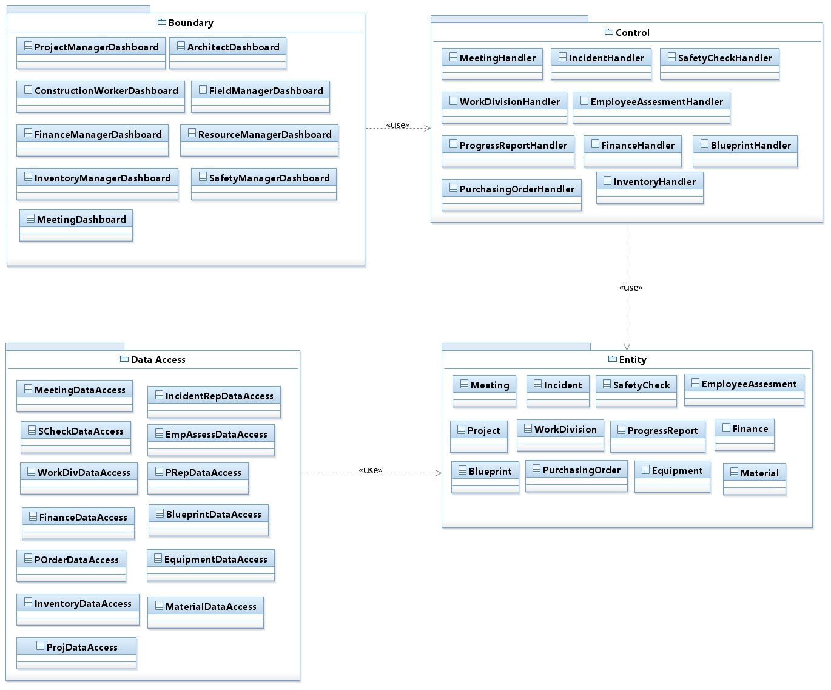
Package Diagram

Slide 30
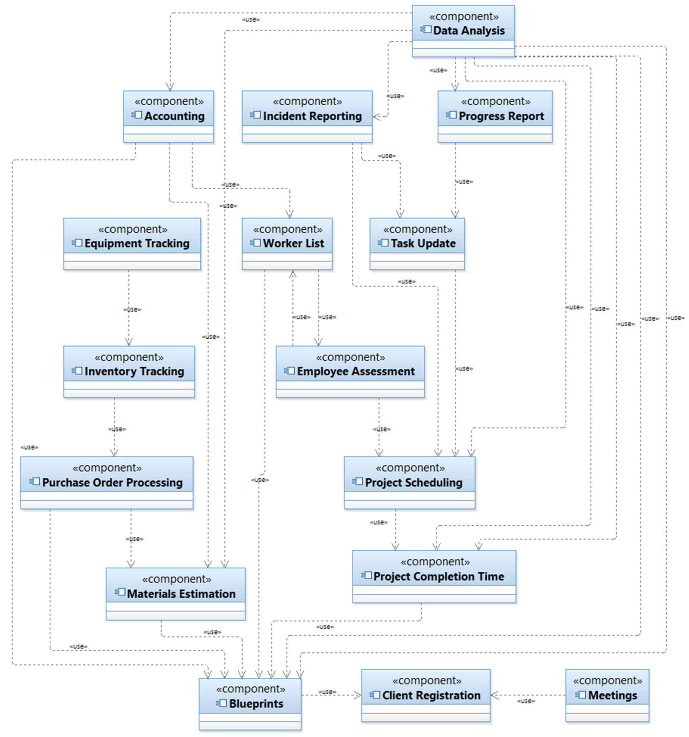
Component Diagram

Slide 31
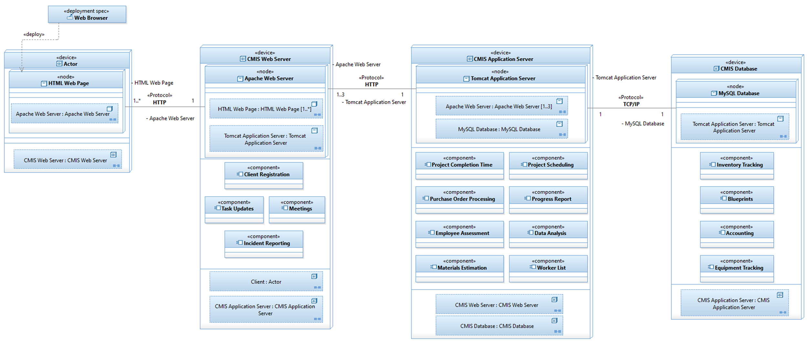
Deployment Diagram

Slide 32
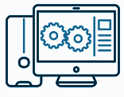
Deliverable 4 Prototype Live Demonstration
6

Slide 33

Questions
Bring it

